Slide 1
Seeing the Impossible Visualizing Latent Variable Models with flexplavaan
Dustin Fife
Steven Brunwasser
Ed Merkle

Slide 2
What is flexplavaan?

Slide 3
flexplavaan = flexplot + lavaan

Slide 4
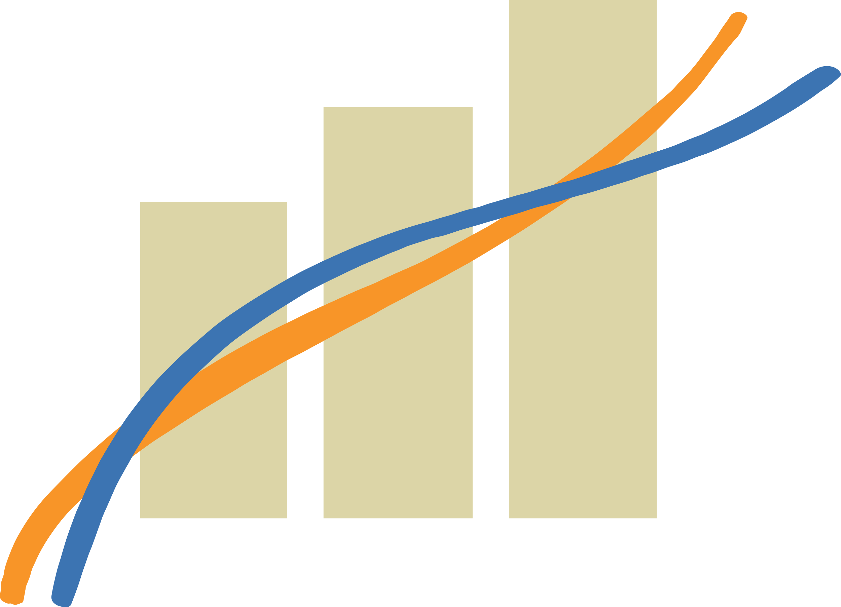

What is Flexplot?
Flexible Plotting
User specifies a model
Flexplot visualizes that model automatically
Emphasis on raw data

Slide 5
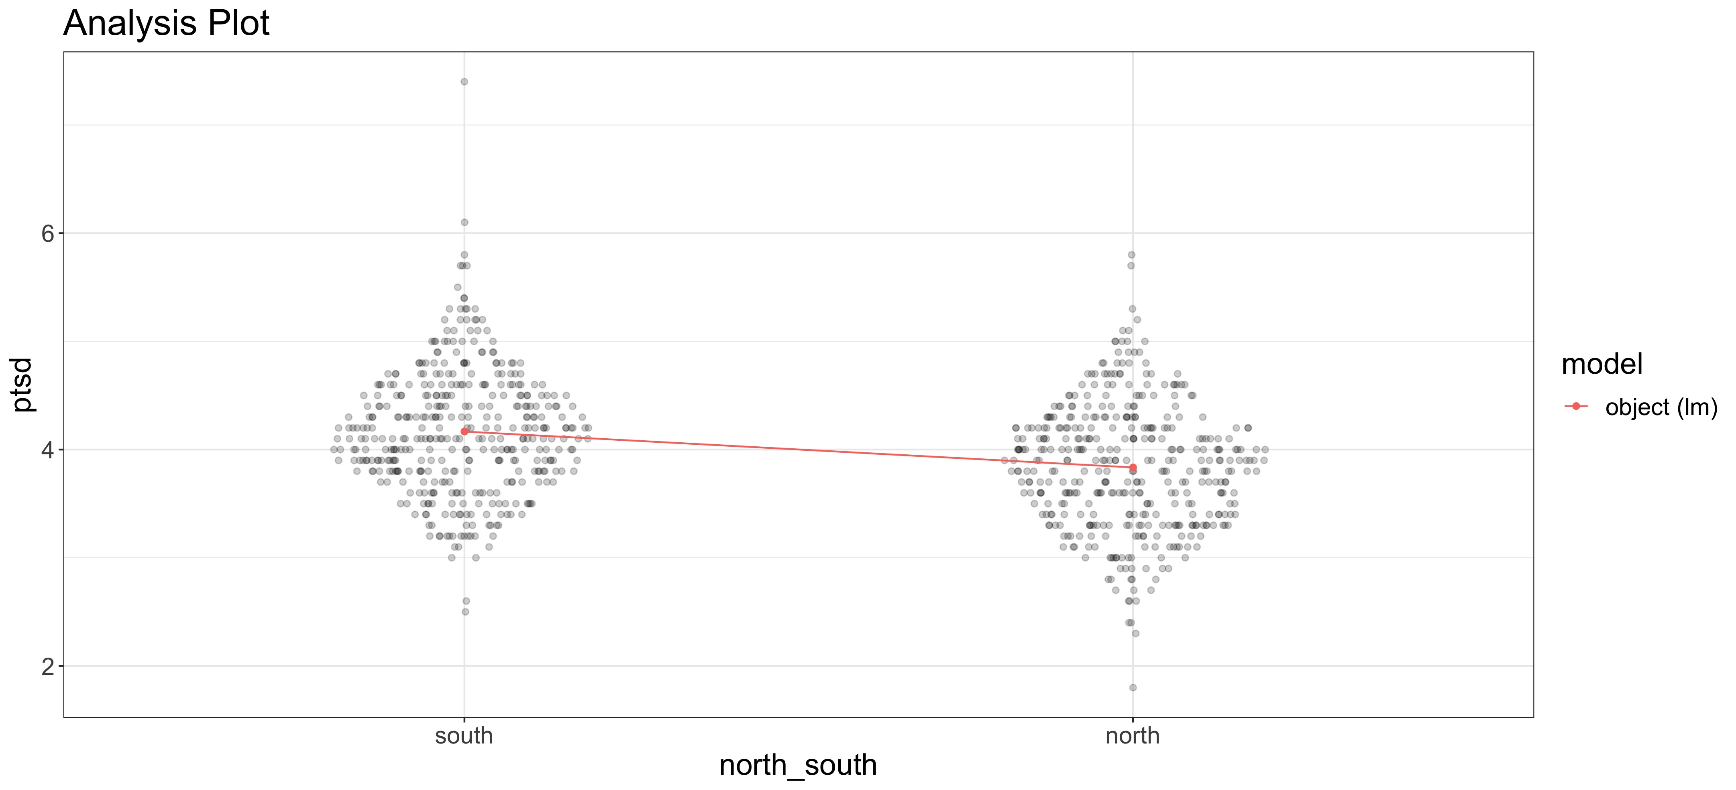
T-Test

Slide 6
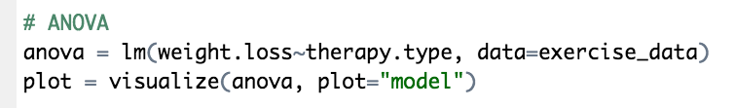
ANOVA

Slide 7
Regression

Slide 8
Mixed Models

Slide 9
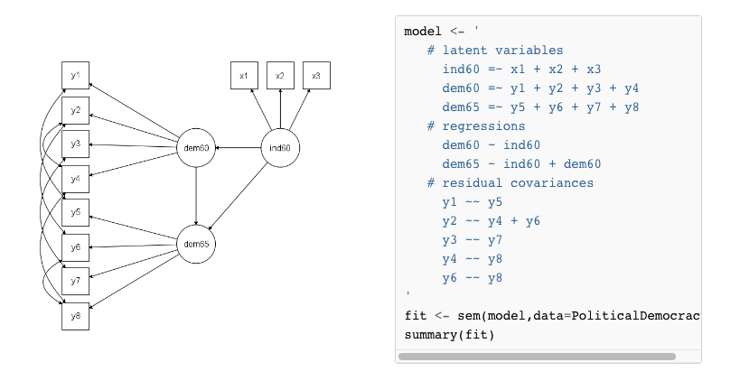
What is lavaan?
Latent Variable Analysis
Use observed variable
To hypothesize latent variables
Software for structural equation models

Slide 10
So...
flexplot + lavaan = flexplavaan
OR
easy plots +latent variable models = flexplavaan

Slide 11
So...
flexplot + lavaan = flexplavaan
OR
easy plots +latent variable models = flexplavaan
Flexplavaan is a software package for visualizing LVMs

Slide 12
But, there’s a problem!

Slide 13
Visualizing Latent Variable Models
They’re invisible!
Raw data??
Covariances

Slide 14
Visualization method
Plot observed variables against observed variables
Overlay the fit implied by the model

Slide 15
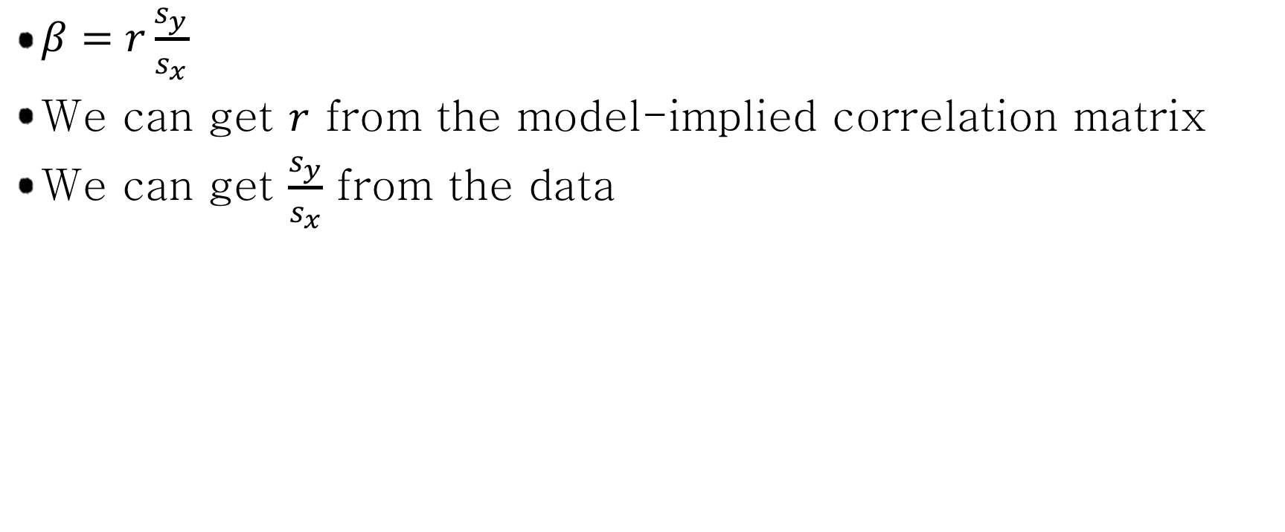
Model-implied fit
$β=r\frac{s_{y}}{s_{x}}$
We can get $r$ from the model-implied correlation matrix
We can get $\frac{s_{y}}{s_{x}}$ from the data

Slide 16
Jedi Example – Assumed Model

Slide 17
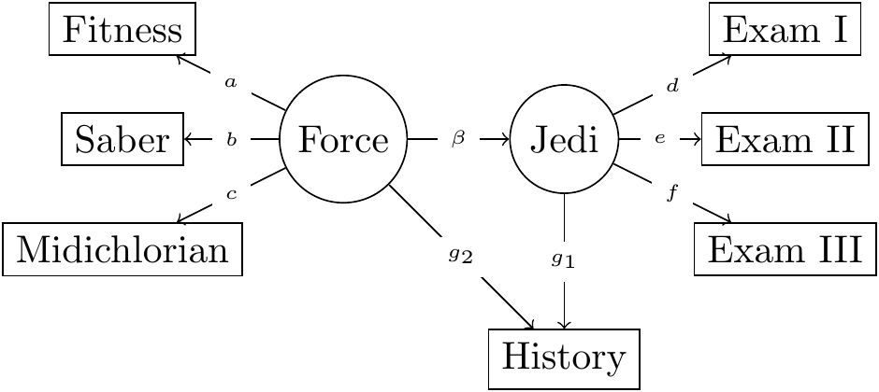
Jedi Example – Correct Model

Slide 18
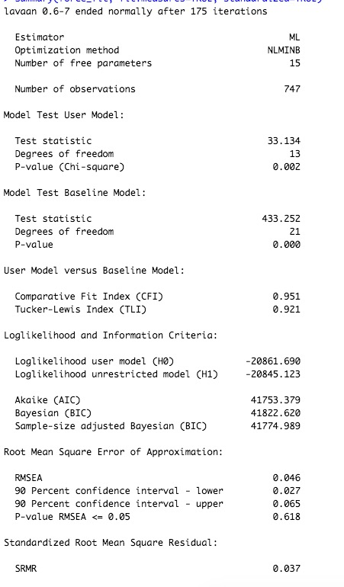
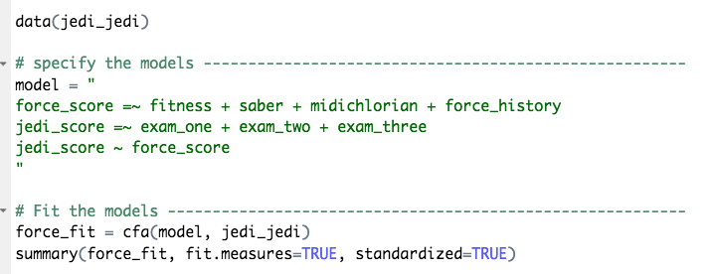
Naïve Analysis

Slide 19
The visuals?
Scatterplot matrix of observed variables
Use implied covariance to estimate the “slope”

Slide 20
We can do better
Disturbance-Dependence Plots
Subtract effect of the model
If any “signal” remains, our model has problems

Slide 21
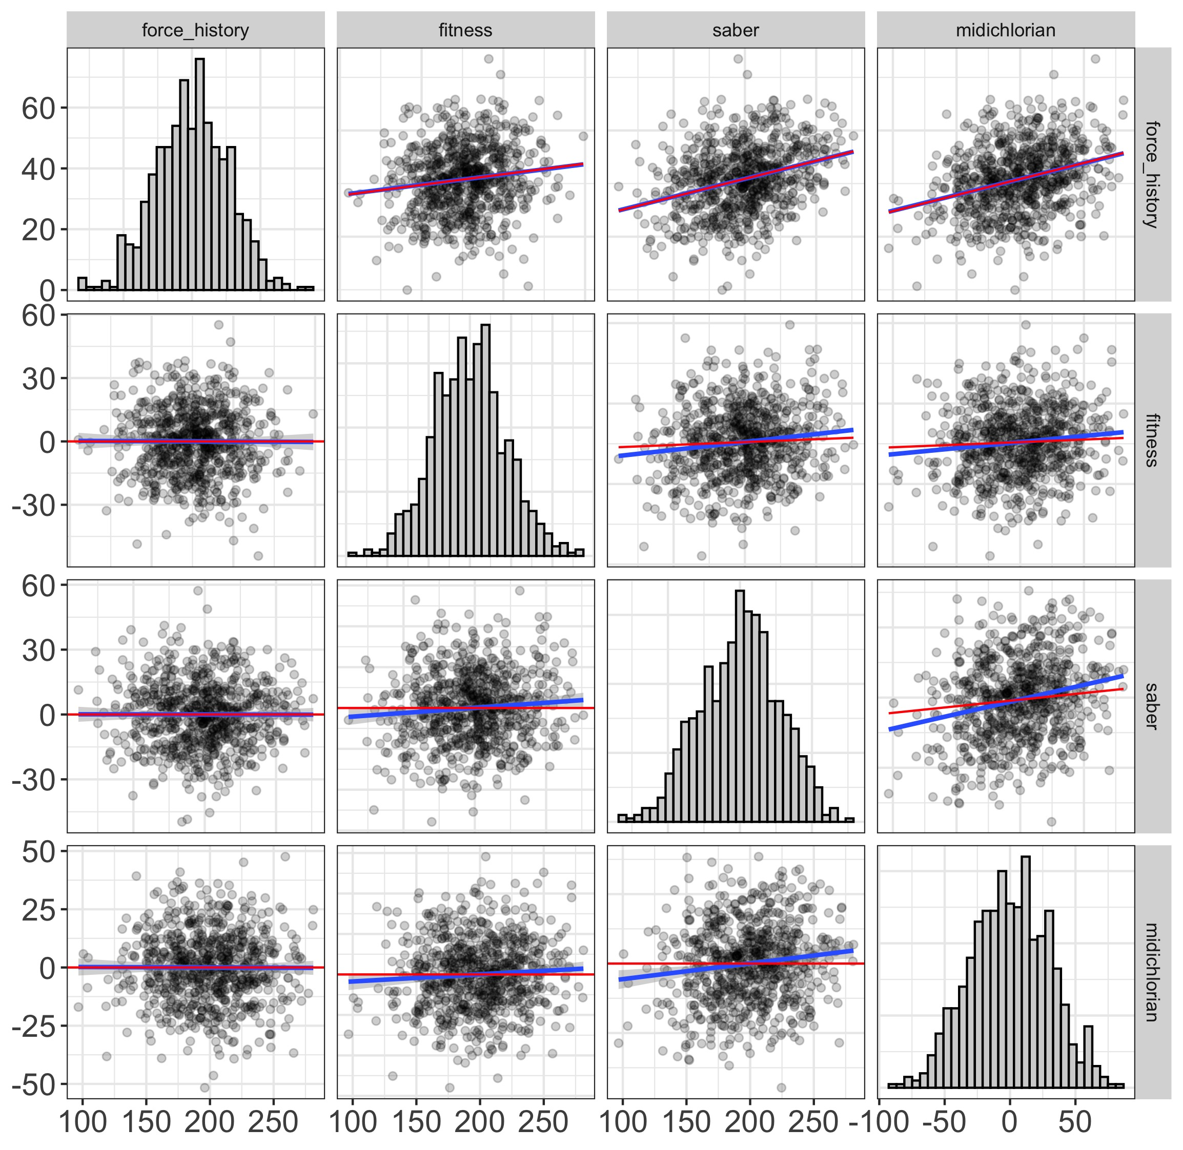
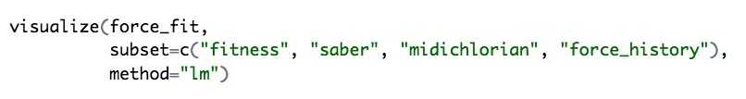
Disturbance-Dependence Plots

Slide 22
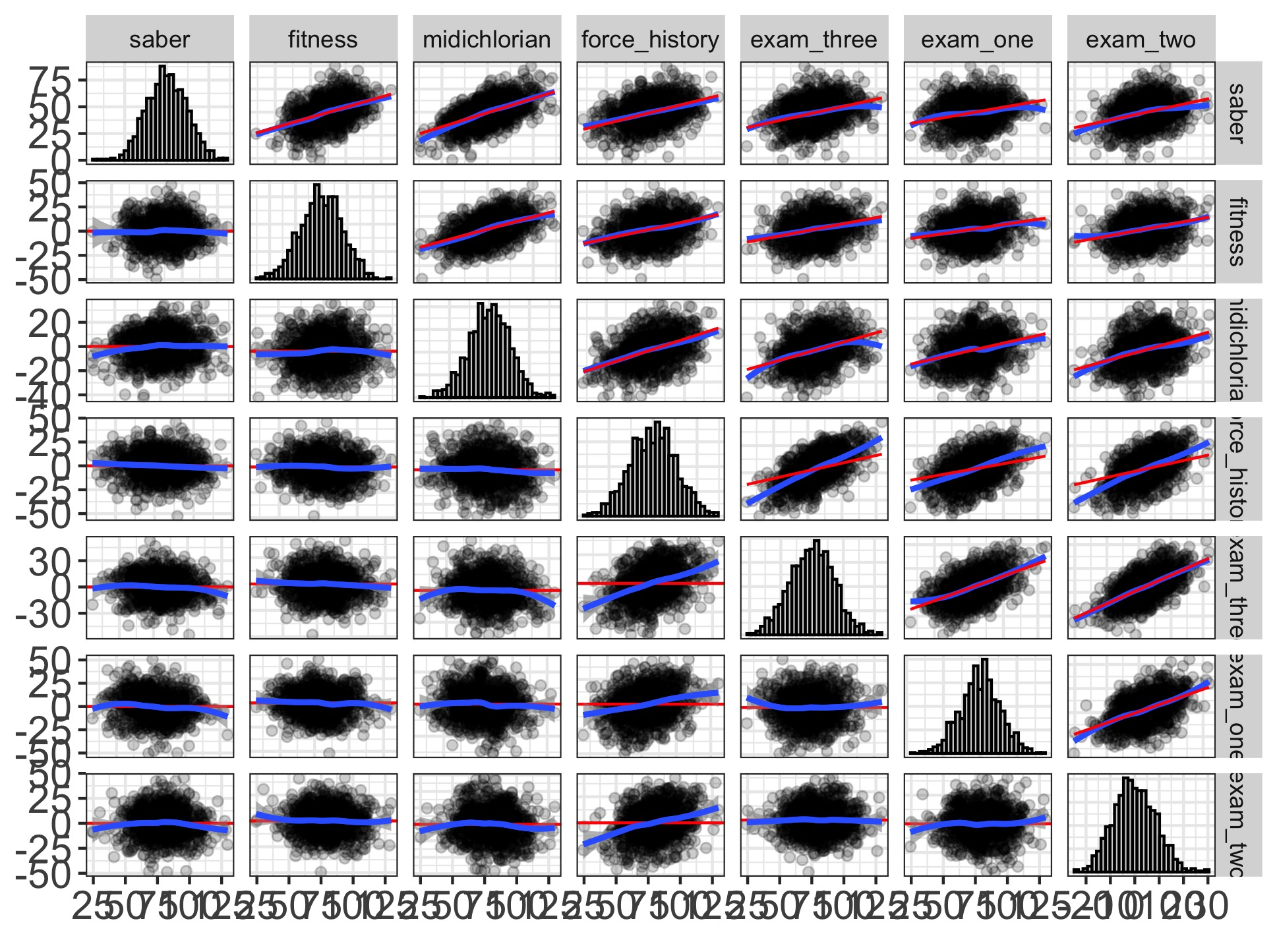

Or the whole model together...

Slide 23
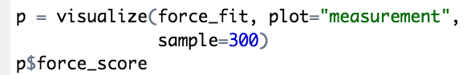
We can also visualize the measurement model...

Slide 24
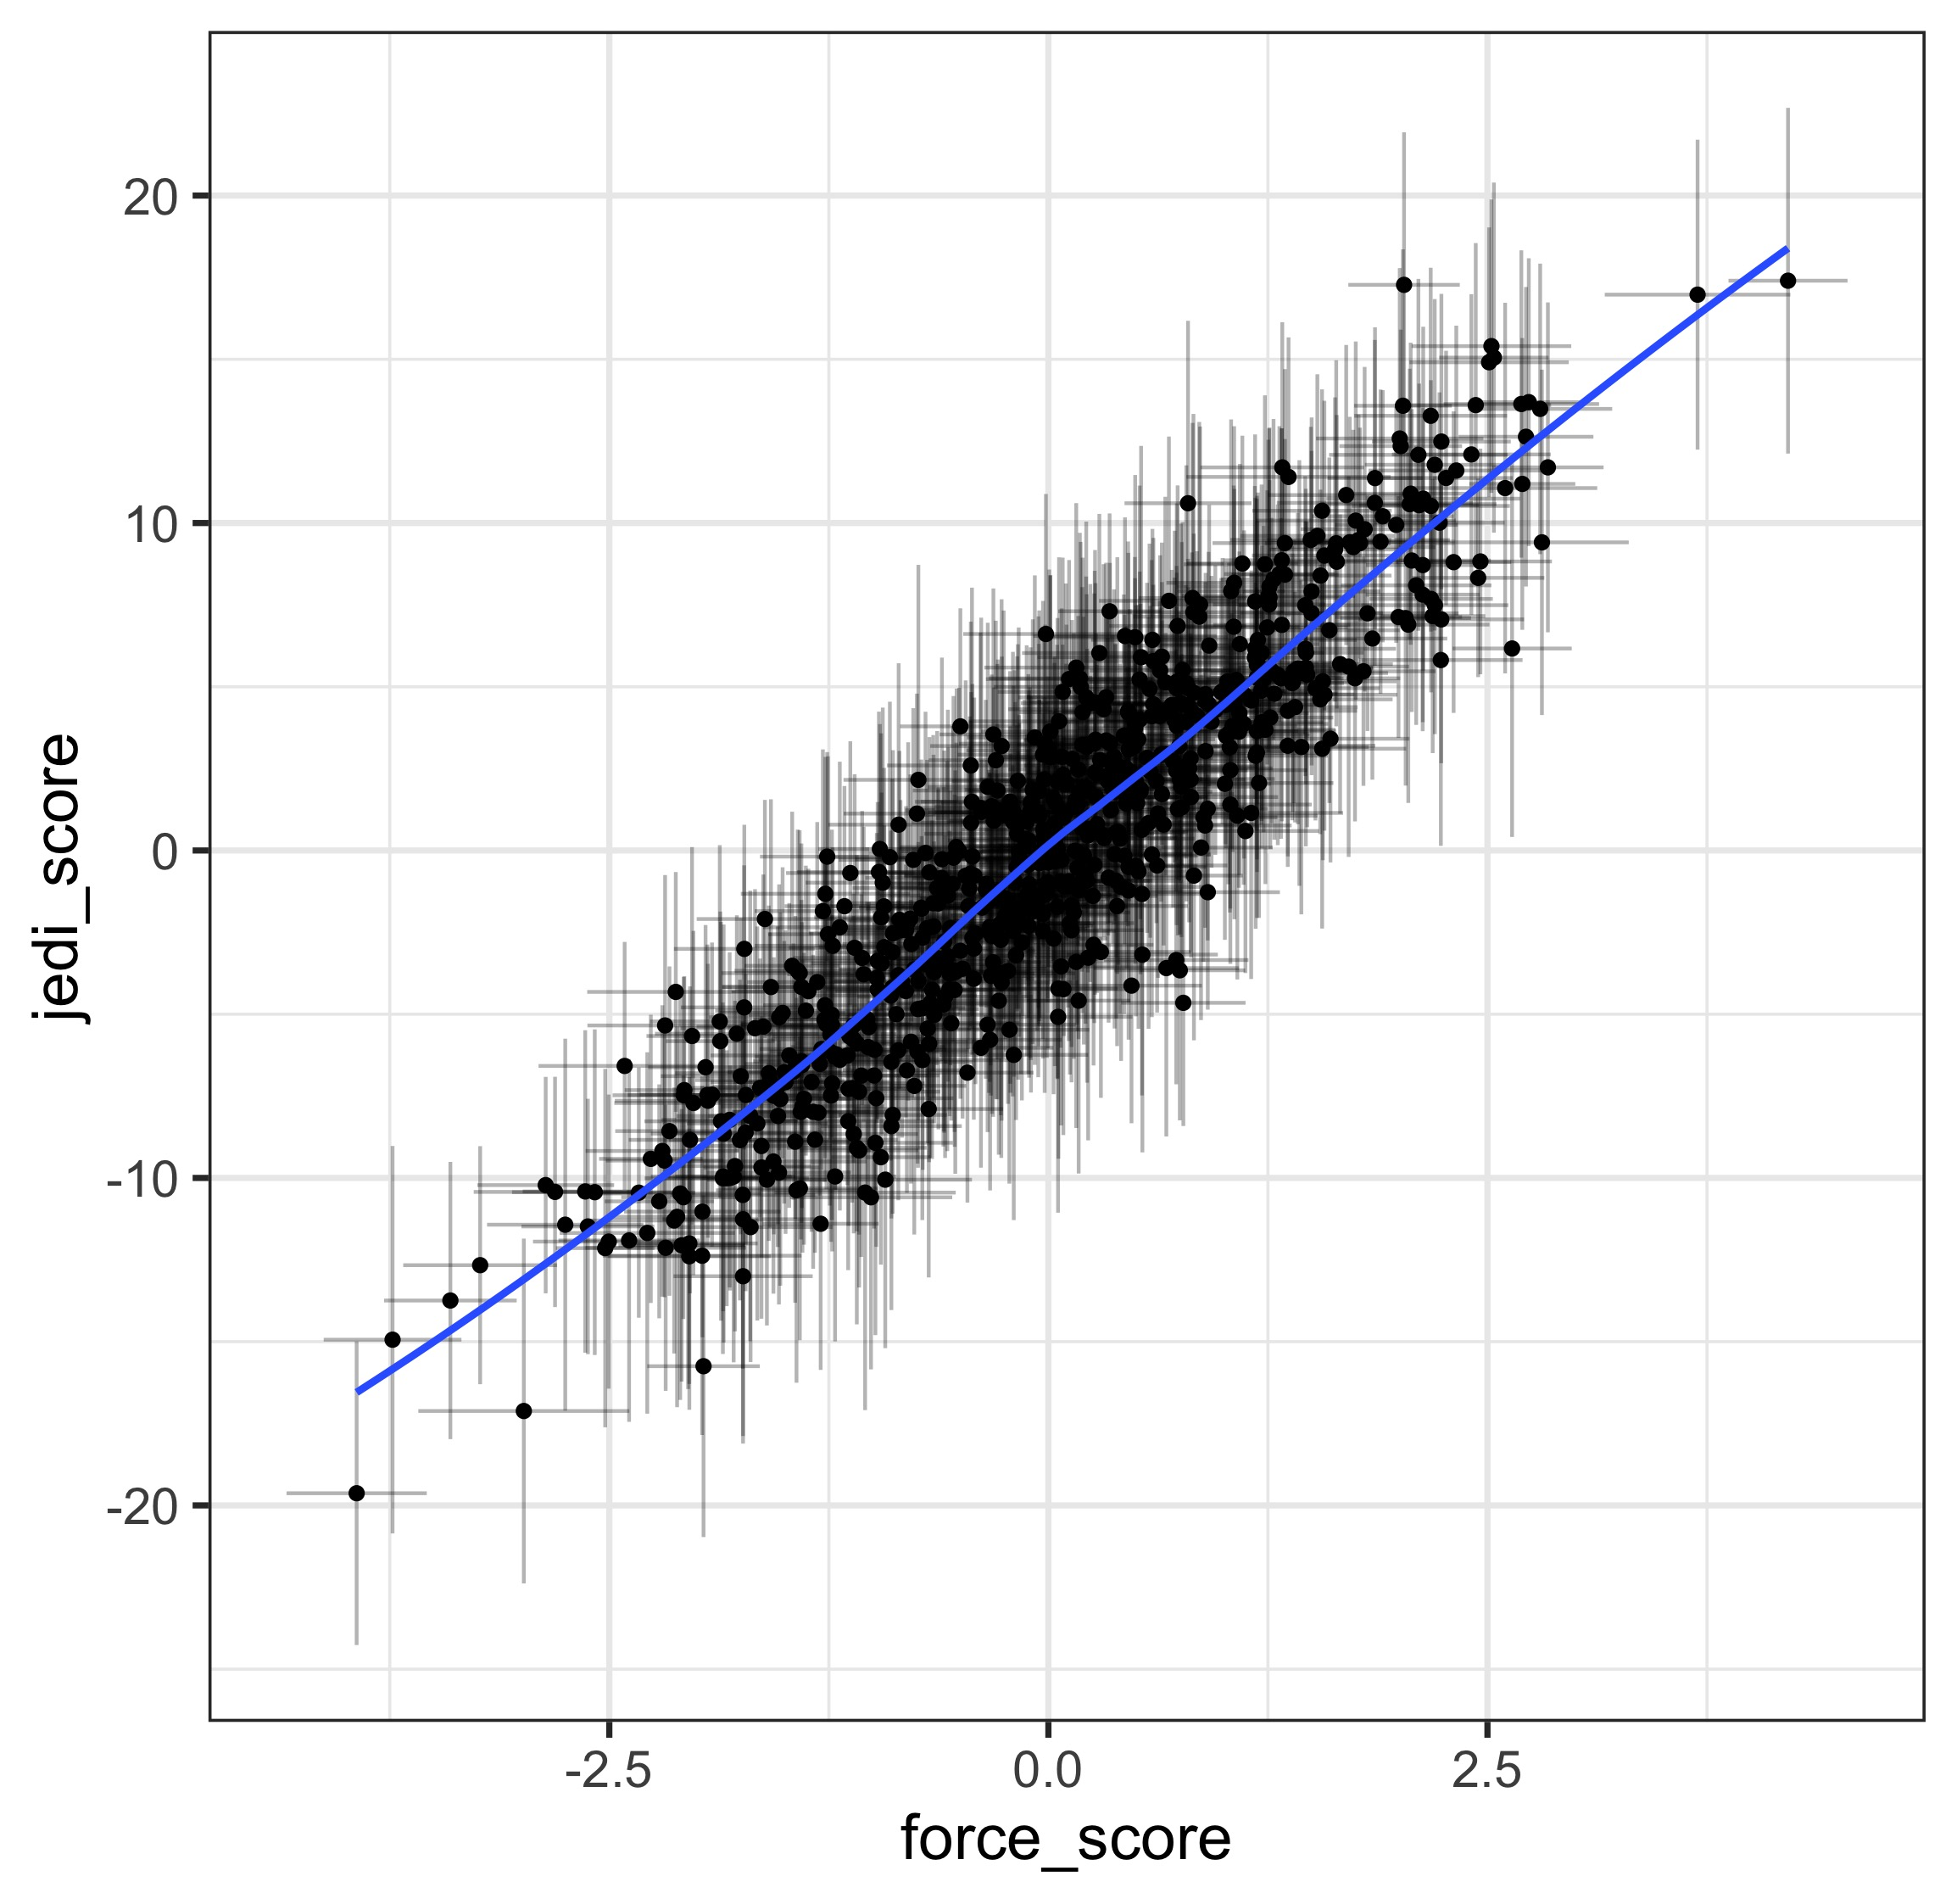
And the structural model...

Slide 25
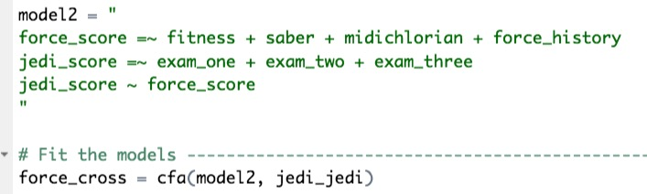
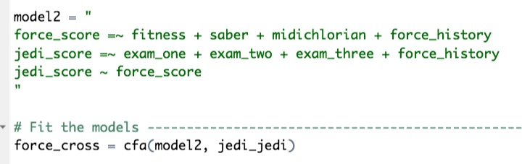
Let’s compare the two models

Slide 26
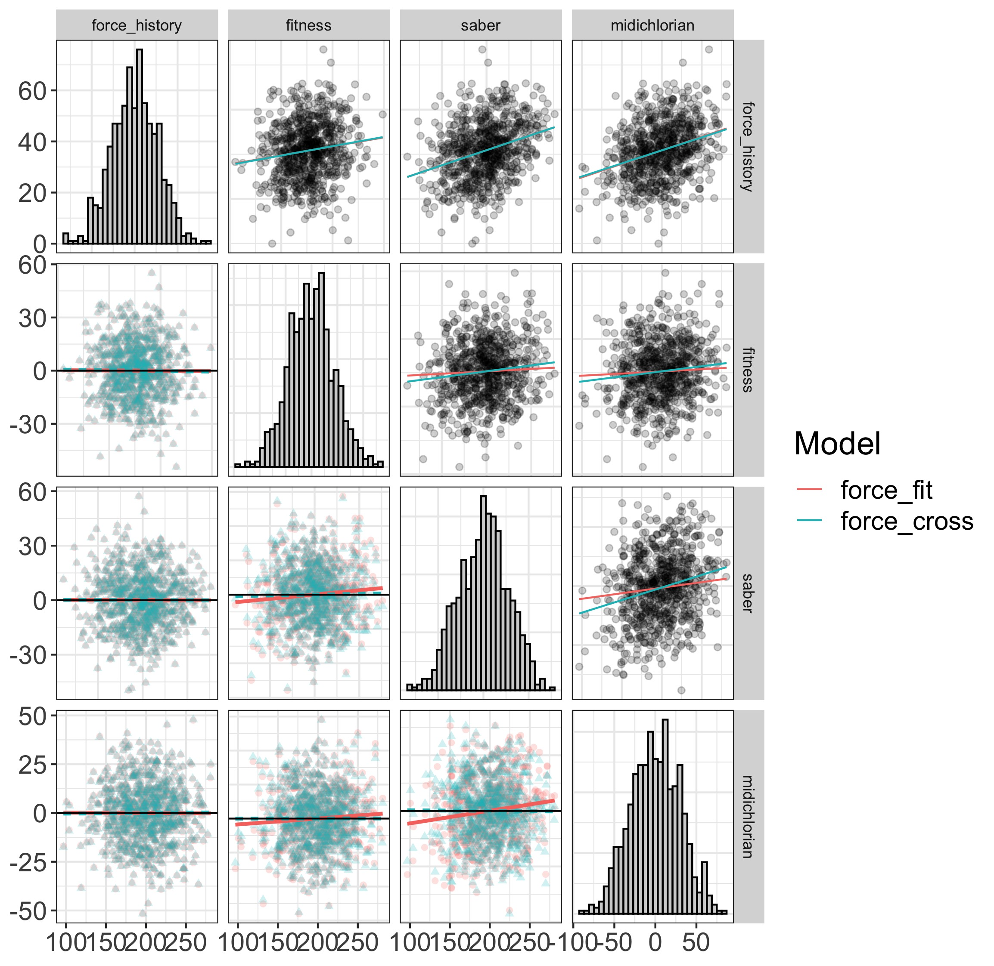
Visually comparing models

Slide 27
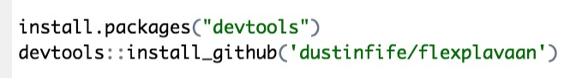
Where to get it?
All in github repository
github.com/dustinfife/flexplavaan

